Slide 1
Student Trading Connection
Group – 8
Kishan Kumar Zalavadia
Ajay Jatprol
Gowtham Sai Lendhra Narayanam
Pavanipriya Vuppalapati
Mohammed Shakeel

Slide 2

Product Vision
The application is FOR students (like UNT students) WHO can trade products with each other. ‘Student Trading Connection’ is a Software as a Service THAT provides a platform where students can trade used products. UNLIKE other apps like Facebook and Amazon OUR PRODUCT is specific to students and has different features that will help us to request to view the product before buying, and can purchase products in groups.

Slide 3

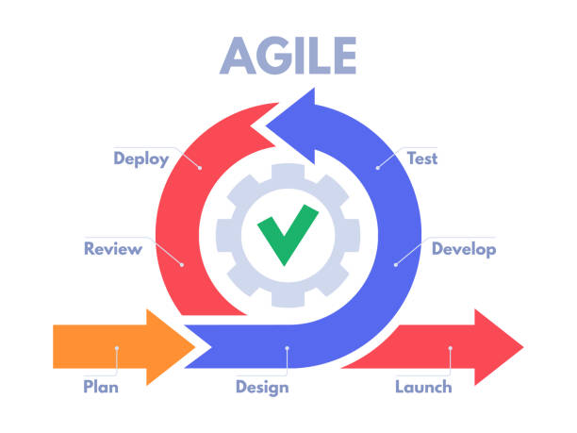
User Stories
1
As a user, I want to have separate portals - one for buying and one for selling with different UI, so that I can distinguish between them and perform specific actions based on my intentions.
As a student buyer, I want the student seller's contact information so that I can contact the seller easily for any queries.
As a student buyer, I want to send an “In-Person Inspection Request” to the seller with instant purchase, so that I can examine the product before making a purchase decision and purchase it on the spot if I like it.
As a student user, I want the option to participate in group purchases for educational resources like e-books, so that I can access these materials at a lower cost.
As a student, I want to earn bonus points with every sale or purchase that I make, so that I can boost my profile to levels like gold, silver, or platinum, showcasing my achievements.
As an admin, I want access to an admin page where I can manage user accounts, and monitor platform activity to ensure the platform’s smooth operation.
2
3

Slide 4







Tools and Technologies
 | Framework | Language | Platform/IDE
Frontend | Angular | Typescript | VS Code
Backend | Spring Boot | Java | IntelliJ IDE
Database | MySQL | MySQL | MySQL
API Testing | Postman |  | Postman

Slide 5
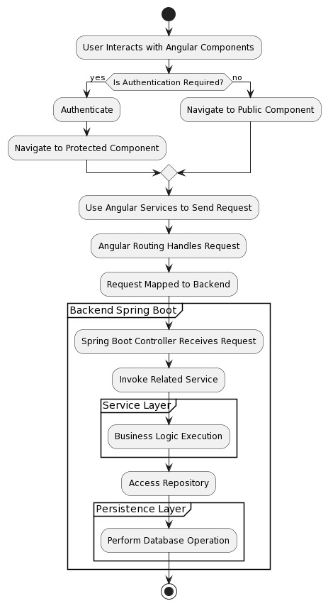
Work Flow

Slide 6
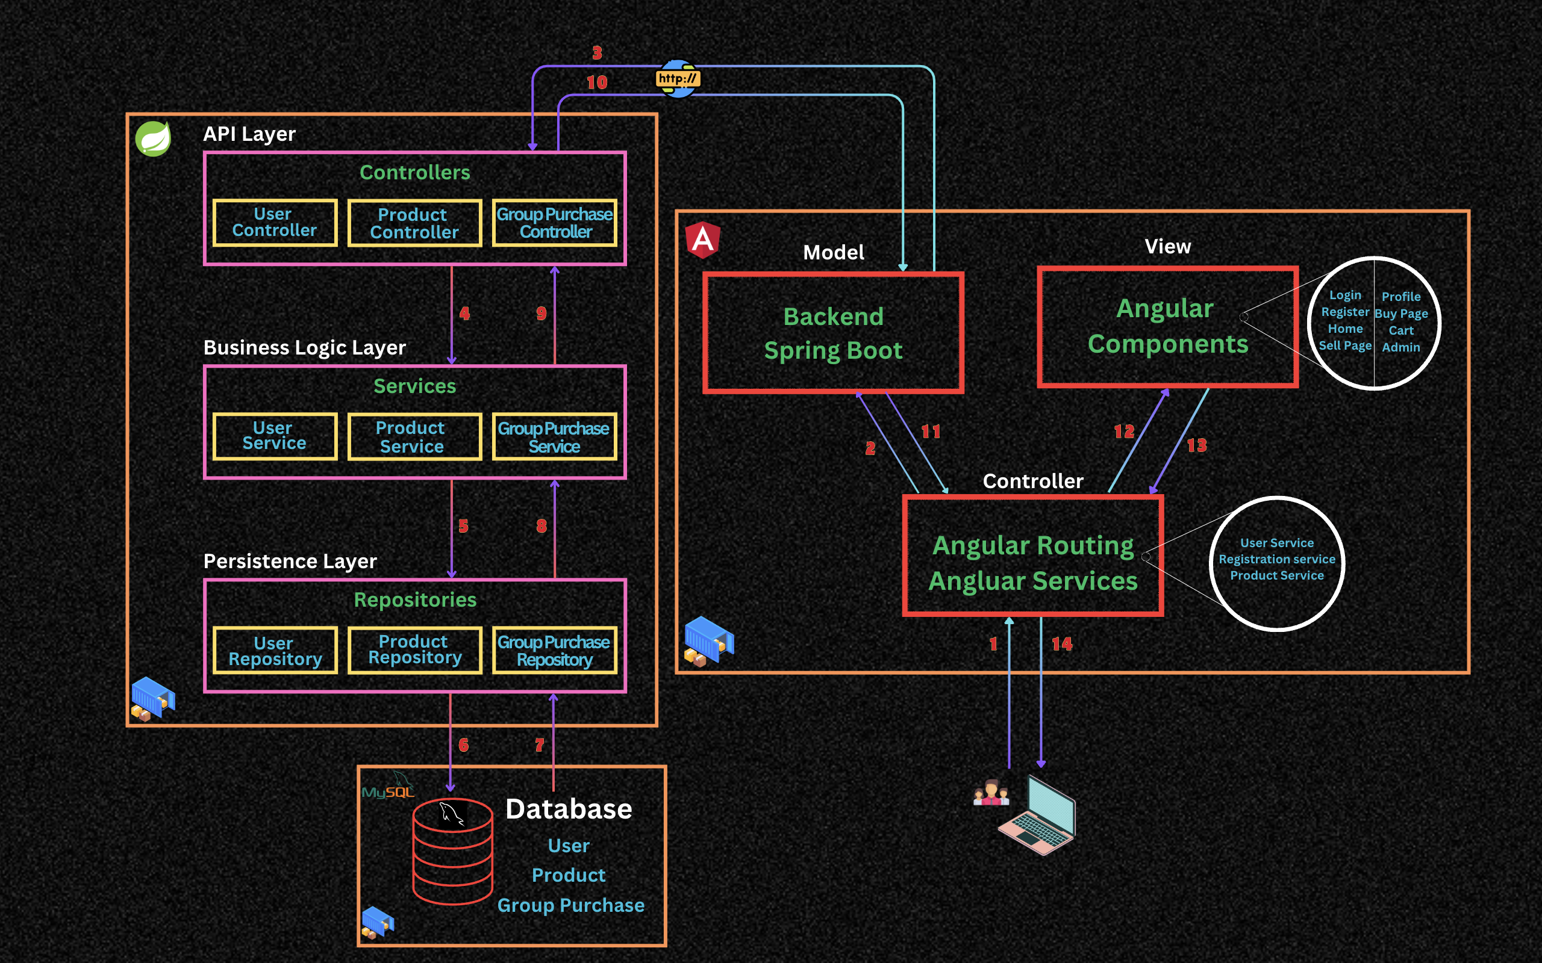
Software Architecture

Slide 7
Backend – Spring Boot
User
Register User
Login User
Fetch user
List all Users
Update User Profile
Increase Bonus Points
Product
Save Product
Get Product
Delete Product
Update Product
Get Available products
Group Purchase
Save Group Purchase
Get Group Purchase Product

Slide 8
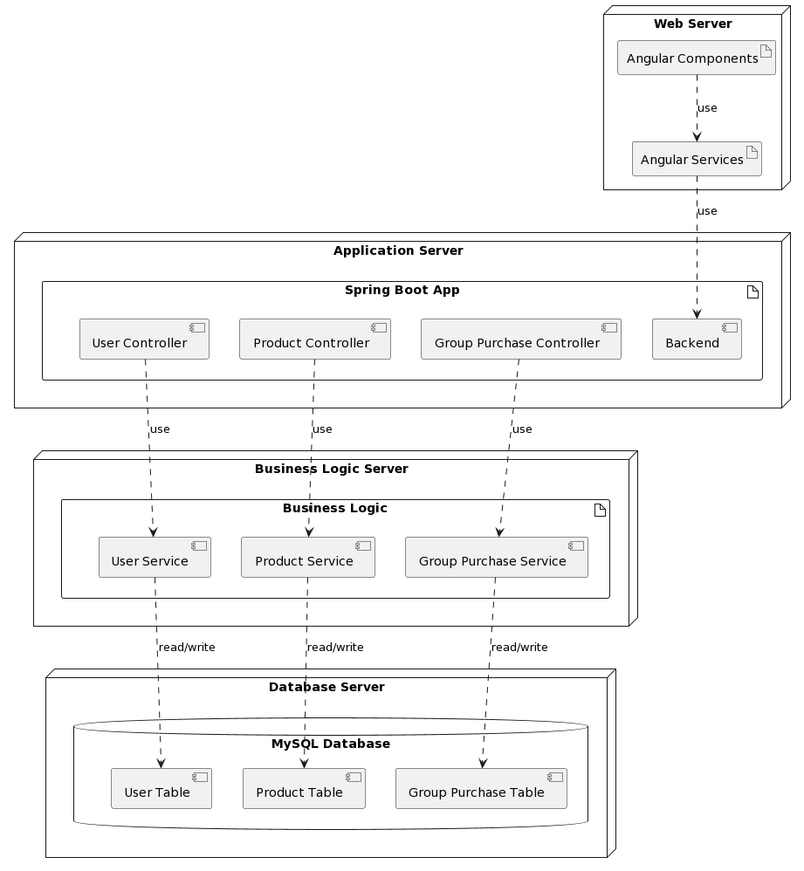
Deployment Diagram

Slide 9
Thank You

